Slide 1
Endocrine physiology

Slide 2
Unit 1

Slide 3
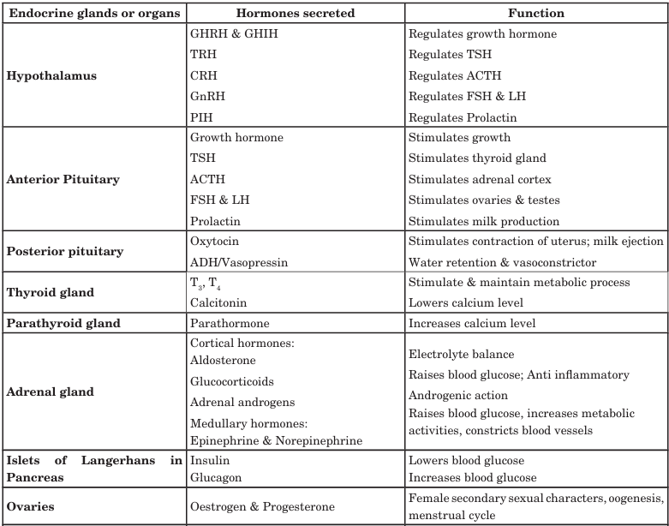

Slide 4
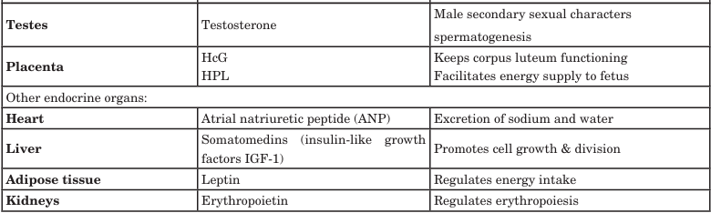

Slide 5
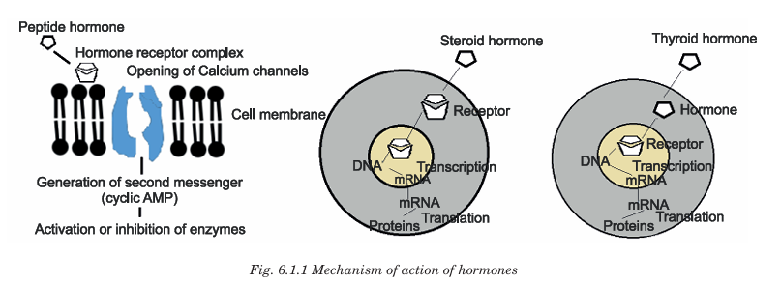

Slide 6
Applied aspects
Most endocrine disorders (endocrinopathies) can be attributed to one of the following problems:
1) Too little hormone, hyposecretion.
2) Too much hormone, hypersecretion; or
3) Abnormal tissue response to a hormone, end organ insensitivity or resistance.
Each endocrinopathy will be explained in the subsequent chapters

Slide 7
Unit 2

Slide 8
Posterior pituitary gland
Pituitary gland is the master endocrine gland.
It is located at the base of the brain.
It is attached to the hypothalamus and lies in the sella tursica of the sphenoid bone.
It is developed from Rathke’s pouch and weighs 600 mg.
It is divided into anterior pituitary (adenohypophysis) and posterior pituitary (neurohypophysis).

Slide 9
Hypothalamo–Hypophyseal Relationship
It refers to the structural and functional connection between the hypothalamus and the pituitary gland (hypophysis), which allows the hypothalamus to regulate pituitary hormone secretion.
The pituitary gland has two parts:
Anterior pituitary (Adenohypophysis)
Posterior pituitary (Neurohypophysis)
Each part connects to the hypothalamus in a different way.

Slide 10
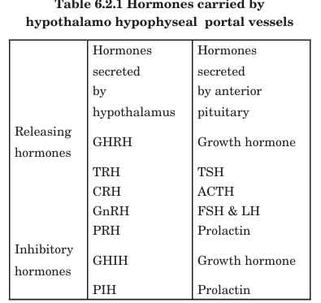

Slide 11
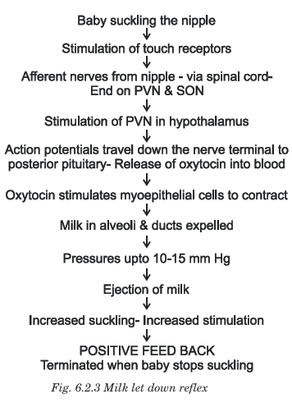

Slide 12
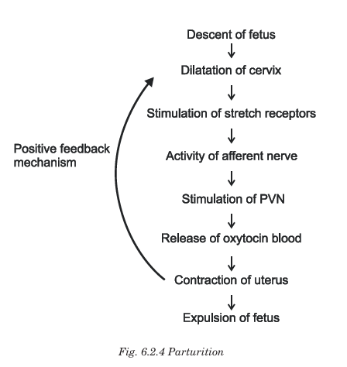

Slide 13
Applied anatomy
Diabetes insipidus occurs due to vasopressin deficiency. Inability to reabsorb water by the kidneys could be either due to a central cause (neurogenic vasopressin is not produced) or could be due to a renal cause (Nephrogenic - defects of the V2 receptors). Mutation of vasopressin gene, mutation of V2 receptor gene or mutation of AQP2 gene also results in diabetes insipidus. Clinical features include polyuria (increased excretion of water) and polydipsia (excess thirst). Synthetic oxytocin is given to induce labor and is given therapeutically in order to decrease immediate postpartum hemorrhage

Slide 14
Unit 3

Slide 15
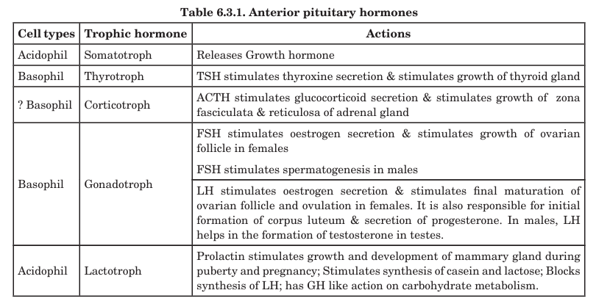

Slide 16
Growth hormones
Other names: Somatotropin / Somatotropic hormone
Source: Anterior pituitary (Adenohypophysis)
Cells: Somatotrophs
Regulation
Stimulated by: GHRH (Growth Hormone–Releasing Hormone, from hypothalamus)
Inhibited by: Somatostatin (from hypothalamus)
Negative feedback: IGF-1 (Insulin-like Growth Factor-1)

Slide 17
Actions of Growth Hormone
GH has direct effects and indirect effects (via IGF-1).

Slide 18
Direct Actions (GH-dependent)
Occurs mainly on carbohydrate and lipid metabolism.
System | Action | Result
Protein metabolism | ↑ Amino acid uptake, ↑ protein synthesis | ↑ Tissue growth
Fat metabolism | ↑ Lipolysis | ↑ Free fatty acids (energy source)
Carbohydrate metabolism | ↓ Glucose uptake by cells (anti-insulin effect) | ↑ Blood glucose (diabetogenic action)

Slide 19
Indirect Actions (via IGF-1 / Somatomedins)
GH stimulates liver and other tissues to produce IGF-1.
IGF-1 mediates growth-promoting effects, especially bone and soft tissue growth.
Tissue | IGF-1 Action
Bones (epiphyseal plates) | ↑ Chondrocyte proliferation → ↑ Linear growth (height)
Muscles | ↑ Protein synthesis → ↑ Muscle mass
Soft tissues & organs | ↑ Cell proliferation → Increased organ growth

Slide 20
Applied aspect
Dwarfism
Gigantism
Acromegaly

Slide 21
Dwarfism
Feature | Description
Short stature | Height below normal for age
Normal body proportions | In pituitary dwarfism
Disproportionate limbs | Seen in achondroplasia
Delayed skeletal maturation | Delay in epiphyseal growth
Delayed puberty | Due to pituitary hormone deficiency
Normal intelligence | Except in hypothyroid or genetic syndromes

Slide 22
Gigantism
System | Manifestations
Growth | Extreme height, large hands and feet, enlarged facial features
Skeletal | Joint pain, kyphosis due to bone overgrowth
Metabolic | Hyperglycemia, insulin resistance → pituitary diabetes
Neurologic | Headache, visual field defects (bitemporal hemianopia) due to optic chiasm compression
General | Excessive sweating, fatigue

Slide 23
Acromegaly
Characteristic physical changes
Enlarged hands and feet (increase in shoe/ring size)
Coarse facial features
  Prominent jaw (prognathism)
  Enlarged nose, lips, ears
  Thickened tongue (macroglossia)
Spacing of teeth (diastema)

Slide 24
Acromegaly
Musculoskeletal & other features
System | Manifestations
Skeletal | Bone pain, arthritis, kyphosis
Skin | Thick, oily skin, excessive sweating
Metabolic | Insulin resistance, hyperglycemia → pituitary diabetes
Cardiovascular | Cardiomegaly, hypertension
Neurological | Headache & visual field defect (bitemporal hemianopia) due to optic chiasm compression
Reproductive | Decreased libido, infertility due to pituitary tumor effects

Slide 25
Unit 4

Slide 26
Thyroid gland
The thyroid gland is an endocrine gland located in the neck, composed of two lobes connected by an isthmus.
It produces the hormones:
T₃ (Tri-iodothyronine)
T₄ (Thyroxine)
Calcitonin
T₃ and T₄ regulate body metabolism and growth, while calcitonin regulates calcium homeostasis.

Slide 27
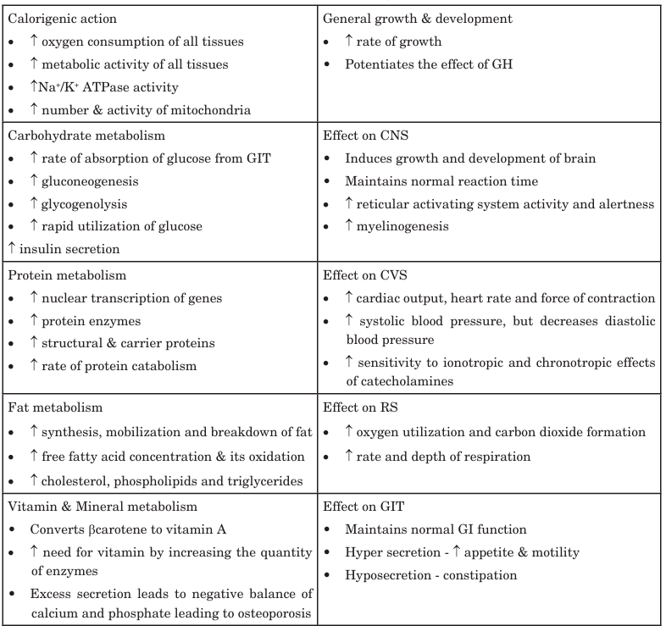

Slide 28
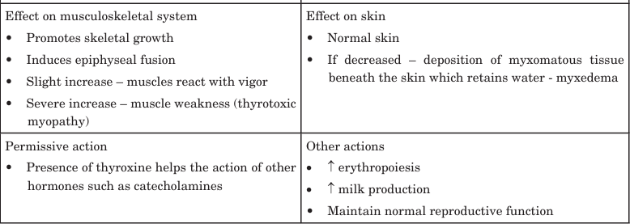

Slide 29
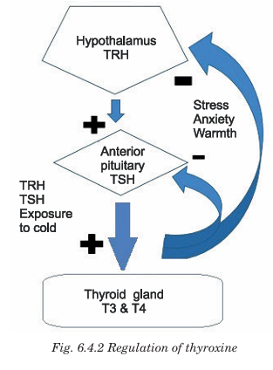

Slide 30
Applied aspect
Cretinism
Myxoedema
Graves diseases

Slide 31
Cretinism
System | Features
Growth | Short stature, dwarfism
Skull/Face | Large head, protruded tongue, flat nose
Neurological | Mental retardation, delayed milestones
Other | Dry skin, pot-belly, umbilical hernia

Slide 32
Myxoedema
Manifestation | Description
Face | Puffy face, swollen eyelids
Skin | Dry, coarse, cold skin
Metabolism | Weight gain, intolerance to cold, low BMR
CVS | Bradycardia
CNS | Lethargy, slow mental activity, depression
Others | Hoarse voice, hair loss, constipation

Slide 33
Graves diseases
System | Features
Metabolic | Weight loss despite increased appetite, heat intolerance
CVS | Tachycardia, palpitations, ↑ BP
Nervous system | Anxiety, irritability, tremors, hyperactivity
Skin | Warm, moist skin, excessive sweating
Eyes | Exophthalmos (bulging eyes) — characteristic feature
Thyroid | Goiter (diffuse enlargement)

Slide 34
Unit 5

Slide 35
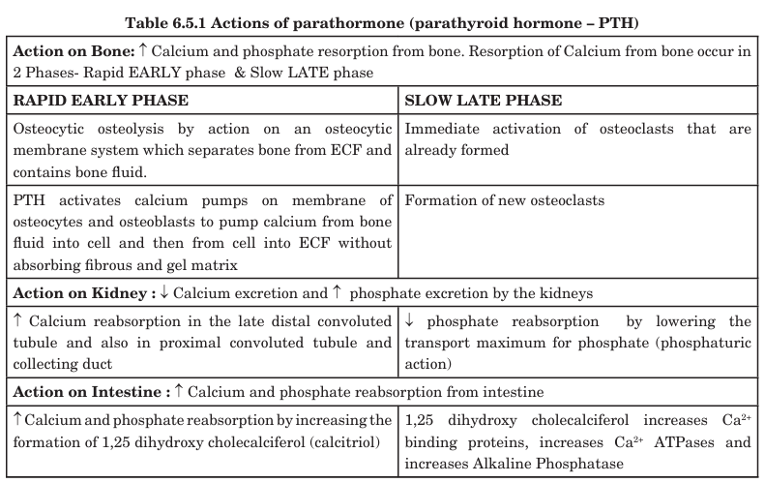

Slide 36
Applied aspects
Hypoparathyroidism may occur due to inadvertent removal of parathyroid glands during thyroid surgery. Hypocalcemia (plasma calcium falls to 6 – 7 mg/dl) leads to tetany. Signs of Tetany include the following: (i) increased excitability of the nerves and neuromuscular junction (ii) Spasm of muscles of hand - flexion of wrist, flexion of metacarpophalangeal joints and hyperextension of fingers - Carpopedal spasm, Accoucher’s hand; (iii) spasm of feet – feet extended at ankle and toes plantar flexed (iv) Laryngeal stridor- contraction of laryngeal muscles leads to closure of glottis and crowing sound during air entry. Latent tetany is manifested by Chvostek’s sign (tapping facial nerve at angle of jaw causes quick contraction of facial muscles on that side) and Trousseau’s sign (carpopedal spasm). Other causes of tetany include vitamin D deficiency and metabolic alkalosis.

Slide 37
Applied aspects
Hyperparathyroidism: can occur due to large doses of PTH or due to a parathyroid tumor. It is manifested by hypercalcemia, hypophosphatemia, demineralization of bones, hypercalciuria and formation of renal stones. Secondary hyperparathyroidism can occur in chronic kidney disease, wherein decreased ability of the kidneys to form vitamin D leads to a feedback stimulation of PTH due to low levels of calcium.

Slide 38
Applied aspects
Rickets and osteomalacia : Rickets is a deficiency of calcium and phosphate in extracellular fluid which is mainly due to vitamin D deficiency in children. It can be either due to inadequate exposure to sunlight or due to inadequate intake of provitamins. Adult rickets is termed as osteomalacia and it is due to decreased vitamin D absorption. Renal rickets is failure of damaged kidney to form 1,25 (OH)2 cholecalciferol. Vitamin D resistant rickets is congenital and is due to decreased reabsorption of phosphate by renal tubules

Slide 39
Unit 6

Slide 40
Pancreatic hormones
Cell Type | % of Islet Cells | Hormone Secreted
α (Alpha) | 20% | Glucagon
β (Beta) | 60–70% | Insulin & Amylin
δ (Delta) | 5–10% | Somatostatin
PP / F cells | <5% | Pancreatic Polypeptide
ε cells | very few | Ghrelin

Slide 41
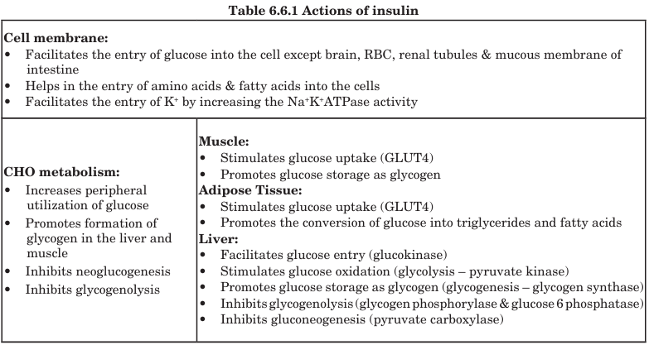

Slide 42
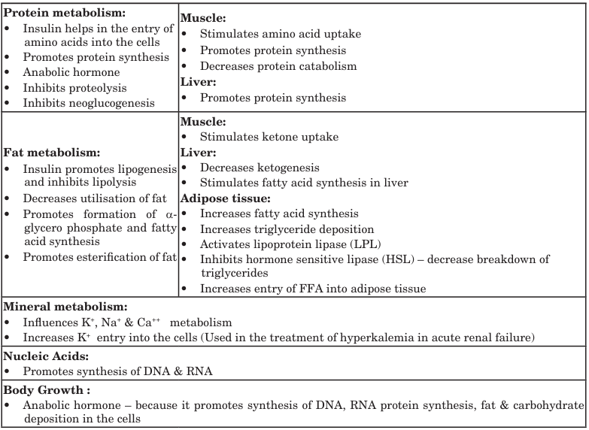

Slide 43
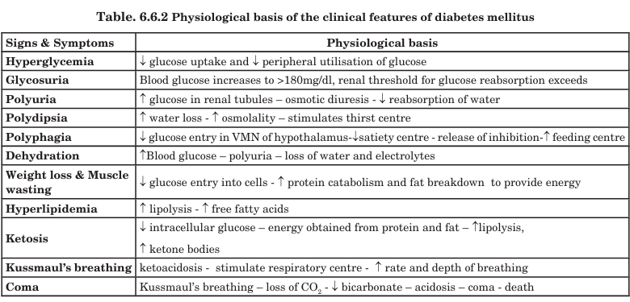

Slide 44
Unit 7

Slide 45
Adrenal cortical hormone
The adrenal (suprarenal) glands are paired endocrine glands located on the upper poles of the kidneys.
Each gland has two distinct parts, both differing in structure & function:
Adrenal Cortex (outer)
Adrenal Medulla (inner)

Slide 46
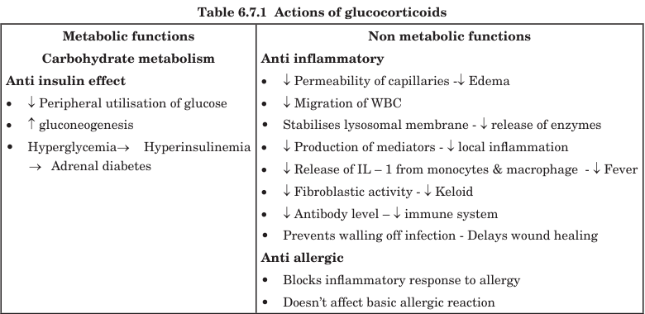

Slide 47
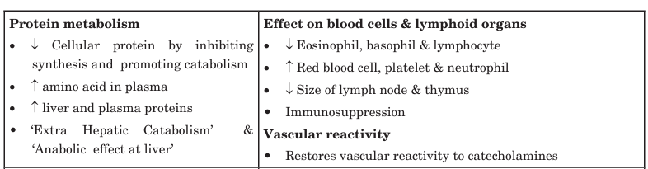

Slide 48
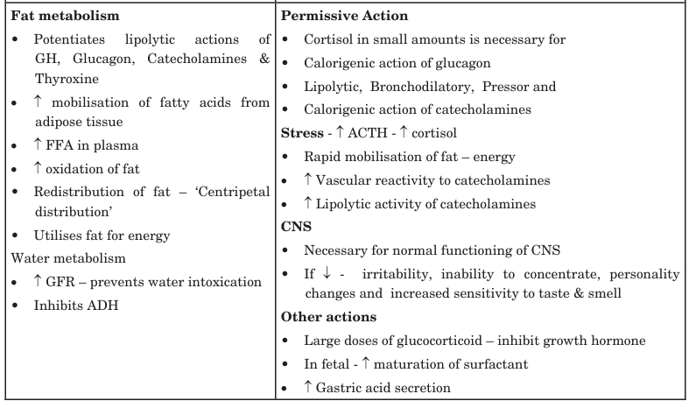

Slide 49
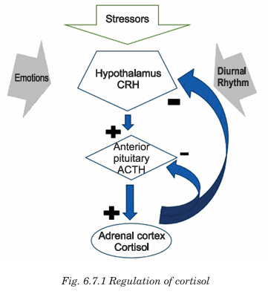

Slide 50
Applied anatomy
Conn’s syndrome: (Primary hyperaldosteronism) This is due to hypersecretion of aldosterone and is manifested by the following: Increased sodium reabsorption causing increase in ECF volume leading to hypertension; ECG showing signs of K+ depletion; increased K+ excretion leading to muscle weakness; hypokalemia leading to metabolic alkalosis which in turn depletes the free calcium resulting in tetany.

Slide 51
Applied anatomy
Cushing’s syndrome: This is due to hypersecretion of cortisol and is manifested by the following clinical features: Skin and subcutaneous tissue becomes thin; Muscles become thin and are poorly developed; Hair becomes thin and rough; Increased capillary fragility ( Ecchymoses); Poor wound healing leading to frequent bruises; Centripetal distribution of fat resulting in thin extremities and pendulous abdomen; Moon face, Buffalo hump, Purplish striae; Hyperglycemia, Glycosuria, Insulin resistance leading to adrenal diabetes; Increased bone reabsorption and decreased bone formation leading to osteoporosis; Increased RBC, platelet and neutrophil; Decreased eosinophil and lymphocyte; Hirsutism, Acne; Growth retardation; Personality changes, Euphoria and insomnia; Edema, hypertension and hypokalemia.

Slide 52
Applied anatomy
Adrenogenital syndrome: This occurs due to hypersecretion of adrenal androgens. In females it is manifested by the following clinical features:, Beard, deeper voice, male type of baldness, masculine distribution of hair, clitoris resembling penis and deposition of protein in skin. In pre-pubertal males, it is manifested by rapid development of sex organs and creation of sexual desire. In adult males, it is difficult to diagnose as its features are obscured by the effects of testosterone. It is diagnosed by estimation of 17 ketosteroids in the urine. (10-15 times ↑)

Slide 53
Applied anatomy
Addison’s disease: This is due to decreased secretion of all adrenocortical hormones. This is manifested by the following features: Hypotension, Hyponatremia, Hyperkalemia, Metabolic acidosis (due to decreased aldosterone); Hypoglycemia, muscle weakness, weight loss, fatigue, lethargy, poor tolerance to stress, decreased RBC, platelets and neutrophil, increased eosinophil and lymphocyte (due to decreased cortisol) and anemia, decreased pubic and axillary hair (due to decreased androgen). Hyperpigmentation of skin & mucous membrane occurs due to hypersecretion of MSH. (↓ cortisol -- negative feedback -- ↑ ACTH -- ↑ MSH)

Slide 54
Unit 8

Slide 55
Adrenal medullary hormones
Adrenal gland also called the suprarenal gland is a triangular or crescentic shaped endocrine organ that is located just above the kidney. Adrenal medulla forms the inner core of adrenal gland and is derived from neural crest.

Slide 56
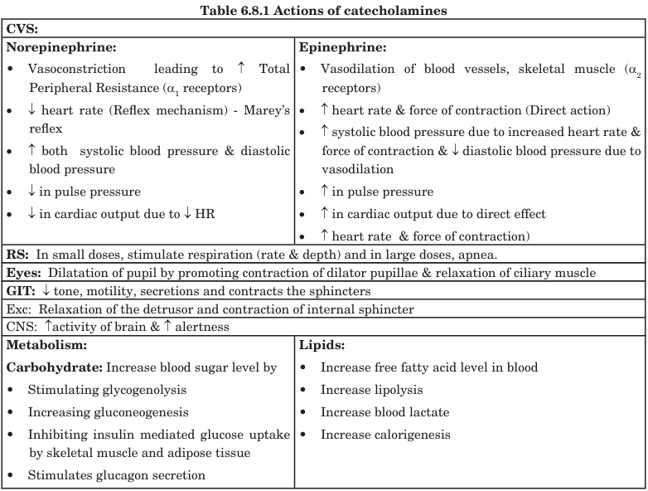

Slide 57
Applied aspects
Pheochromocytoma is a clinical condition which occurs due to a tumor in adrenal medulla leading to increased secretion of catecholamines. Clinical features include the following: headache, palpitation, anxiety, weight loss, hyperglycemia, hypertension, blurred vision and increased urinary excretion of catecholamines, metanephrines and VMA. Treatment is by removal of tumor and by administering α and β receptor adrenergic antagonists. Therapeutic usage of catecholamines include the following: Catecholamine agonist (amphetamine) acts as appetite suppressant. Catecholamine antagonists are used in the treatment of hypertension, hyperthyroidism and coronary artery disease

